Slide 1



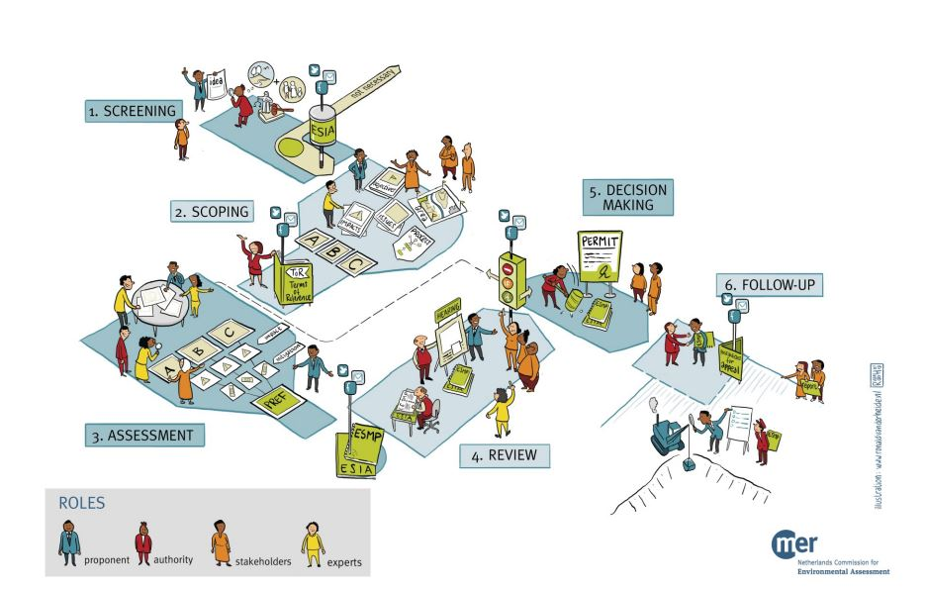







Three ESIAs in Uganda
Highlights and recommendations
Netherlands Commission for Environmental Assessment
Highlights
Click on one of the circles to proceed.
Recommendations
Better communication on stakeholder uptake
Public hearings
Relevant
certificates
Shortly after the first commercial oil was discovered in 2006, the National Environment Management Authority (NEMA) asked the NCEA to help with the environmental assessment process for oil and gas related plans and projects. After providing advice on the strategic environmental assessment (SEA) for exploration in the Albertine Graben region, we advised on three Environmental and Social Impact Assessments (ESIA) for specific projects.
With the ESIA’s now finalised and approved, we would like to share our observations. We hope that these insights contribute to the improvement of ESIA processes and inspire competent authorities, ESIA consultants and stakeholders worldwide to work towards transparent, inclusive and sustainable decision making!
Issueing certificates on right time
ESIA reports
more to-the-point
Participatory review
5 animations on the ESIA process steps
Notes:
Groter plaatje, link naar animatie. Zoom naar animaties

Slide 2


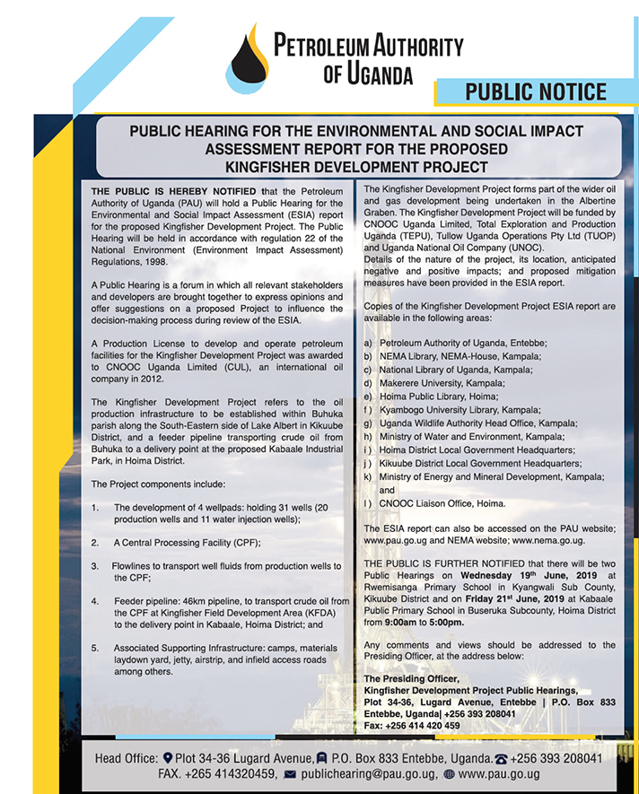

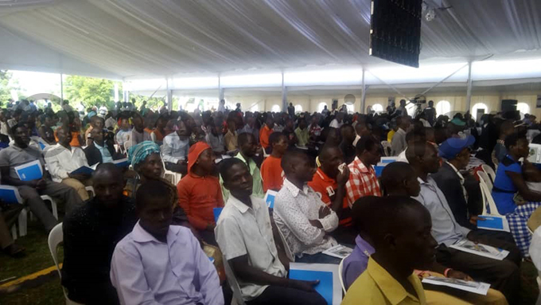
Public hearings
2
Highlights
Recommendations
Project
info
ESIAs
& NCEA
Why is stakeholder participation important?
Stakeholder participation is one of the basic pillars of effective ESIA, together with transparency and quality of information. Early and regular involvement of stakeholders improves the quality and variety of information, such as use of local knowledge, and builds trust and support. It may reduce costs and delays due to conflicts and errors.
It increases understanding of potential impacts.
It also ensures to identify controversial issues and provides a possible forum to resolve these. And it ensures more transparent procedures and increased public confidence in the process, which contributes to better acceptance of decision-making.
The Ugandan ESIA Regulations contain provisions for public hearings and the disclosure of reports. But until recently, this was hardly implemented in practise. In the three ESIA’s for oil projects, a major effort was made to organise public hearings and disclosure of information was given a prominent role. Was it perfect? Not yet, but at least a promising start was made.
Activities included:
NEMA provided summary extracts of the ESIA Reports to the public. These extracts were published in the daily national newspapers for a two-week period.
Technical officers from NEMA and PAU (Petroleum Authority of Uganda) appeared on talkshows to discuss the ESIA’s.
Additional materials (also in local languages) were developed to simplify some of the key issues presented in the ESIA report.
ESIA reports were distributed to various public places and a notice was published in national newspapers how and where to get access and provide input.
PAU organised public hearings and invited stakeholders such as interest groups and NGOs.
Public hearing reports were prepared by the presiding officers and submitted to NEMA.
Responses from the public hearings and written submissions included water quality (contamination) and social and economic aspects such as employment, land governance and compensation. NEMA took a selection of the comments into account in their final decisions.
Improved implementation over time
We saw an improvement in the organisation of the hearings over the course of the three ESIAs. The public hearings of the first ESIA for Tilenga were organised for too many people (1000 persons), in a short time frame, facilitated by a presiding officer who was not considered fully independent by some stakeholders. For the second and third ESIA ( Kingfisher and EACOP respectively) used more time and different locations and had an independent facilitator presiding over the hearings. This was important for public confidence in the continuation of the project.
If content is not automatically enabled, click here for link to video on YouTube.
Click on image for full document
Public hearing for the Kingfisher ESIA
source: NewVision Media
Notes:
Duidelijk maken dat document link bevat naar website. Of… zoom.

Slide 3
Participatory review
3
Highlights
Recommendations
Project
info
ESIAs
& NCEA
Why is a good review process important?
During review, the quality and completeness of the information, the methods used, and the ESIA process at large is checked. If for example, infomation is incorrect it may cause (financial) setbacks during project development. Furthermore, during review the feasibility and management of environmental and social (mitigiation) measures is discussed. It is therefore important that lead agencies and local authorities involved or affected by the project development - other than the proponent - are present. In addition (independent) expertise is a valuable asset. This is why the NCEA is a strong supporter of multidisciplinary review teams. Although organising these teams and sessions seems like a lof of hassle and a lot of extra work, in the end it saves time (and money) and prevents miscommunication between the parties. It ensures that stakeholders have the same mindset and most important, that the ESIA and ESMP are really fit for purpose.
Prior to these ESIAs, NEMA conducted their review process mainly using written comments of relevant stakeholders and ministries, departments and agencies. The comments were sent separatelyto NEMA and included comments on minor errors in texts, which were not really essential shortcomings relevant to decision making.
In 2017, a NEMA delegation visited the NCEA to conduct a five-day review of the scoping report for the ESIA for East African Crude Oil Pipeline (EACOP), together with a working group of experts we had composed for this purpose. NEMA noticed that such a separate working session of a couple of days was highly effective and much more efficient than receiving only written inputs.
In the subsequent ESIA reviews, NEMA invited ca. 40 representatives from lead agencies and local authorities to review the ESIA and the Environmental and Social Management Plan. Instead of working in isolation, the participants discussed the ESIA together, becoming aware of each other viewpoints and reaching consensus on various issues. Although these review sessions are costly*, NEMA aims to make participatory review a common practice in future ESIAs for large projects with significant impacts.
* The participatory review sessions for the Tilenga, Eacop and Kingfiser projects were financially supported by the Oil-for-Development Programme of the Norwegian government.
Improved implementation over time
Since the joint review set up was new to the Ugandan lead agencies and local officials, the quality and result of the sessions improved considerably over time. While the first review had to discuss a huge list of issues, regardless of their relevance, the most recent review session on the EACOP ESIA was already much more focused. The participants identified key issues more easily and discussions were to the point. The fact that most participants knew each other from previous sessions definitely contributed to a productive exchange.
Participatory review meeting in Hoima, February 2019

Slide 4
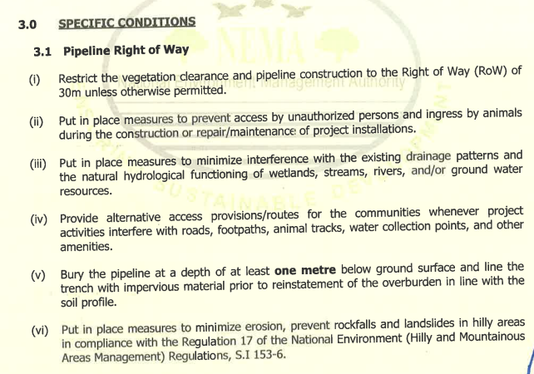
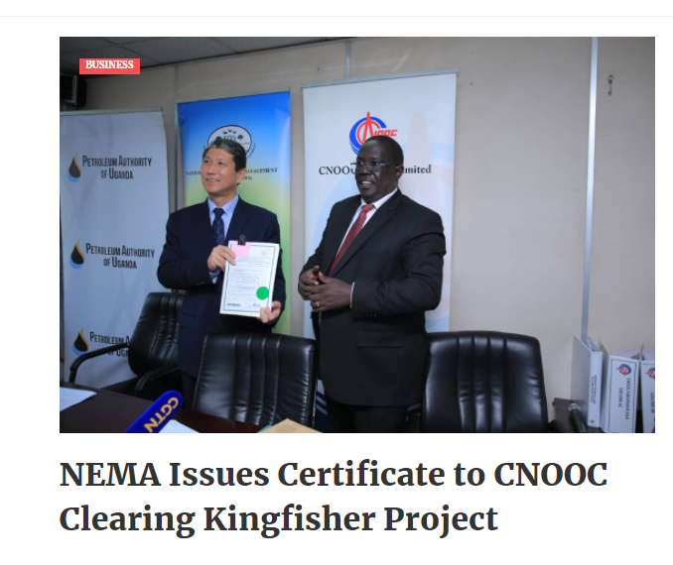
Relevant environmental certificates
4
Highlights
Recommendations
Project
info
ESIAs
& NCEA
Why is a tailormade environmental certificate important?
The environmental certificate guides the compliance and enforcement process during project implementation and operation. Therefore, explicit conditions – based on information from the ESIA - such as amount of waste water, compensatory measures, restrictions in nature areas, are crucial for the compliance and enforcement officers and for the general public. Compliance with these conditions contributes to the sustainability of the project. Since the information for the conditions has already been collected and reviewed during the previous steps, it is a relatively easy step for the competent authority – which issues the certificate – to include this information.
The environmental certificate in Uganda was generally a list with standard conditions including the administrative process. The conditions on the content – although mentioned in the ESIA – were far less in number and detail in the certificate. With support from Norwegian legal experts from the ‘Oil for Development programme’, the design of the certificate was considerably modified.
Design Environmental Certificates Tilenga, Kingfisher and EACOP:
General provisions, which refer to applicable environmental and sectoral regulations; and that commitments made in the ESIA must be met with” and “the ESMP must be implemented”.
Administrative provisions, about validity and transparency.
Specific project related conditionssuch as “provide alternative access routes for the communities…. “ and “Bury the pipeline at a depth of at least one metre below ground…. “
Although the adjustments may seem a small step, we consider them a huge improvement. The certificate and its conditions guide the follow up of the ESIA, the management, monitoring, compliance and communication of the (un)predicted impacts of the approved projects. Thus, if the certificate is of poor quality, the follow-up will not be effective and the project will most likely be less sustainable. The time and effort invested in the ESIA will then not have been used to its full potential.
Environmental Certificate
Tilenga
Environmental Certificate
Kingfisher
Environmental Certificate
EACOP
From the envrionmental certificate for EACOP
4

Slide 5
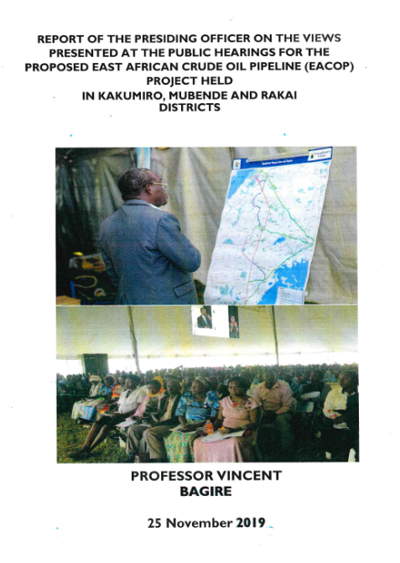

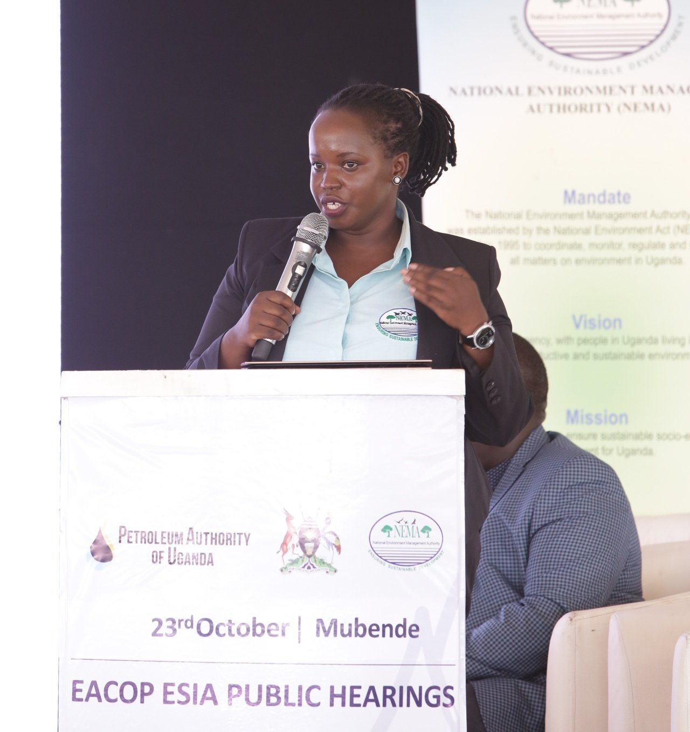
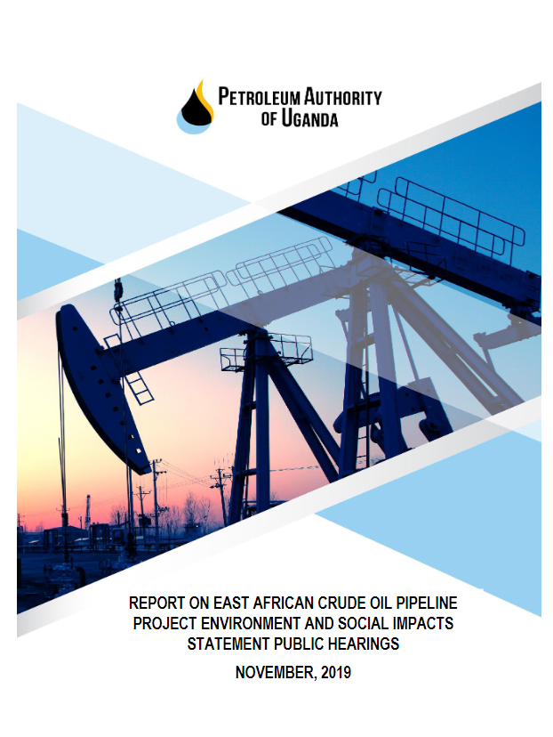
Communicate the outcome of public hearings
5
Highlights
Recommendations
Project
info
ESIAs
& NCEA
As mentioned before, one of the highlights of these ESIAs has been the prominent role of public hearings and disclosure of information. Although not yet perfect, it contributed to transparency of the process, generated relevant issues and obtained media attention.
But one of the main criticisms was that it was unclear exactly what NEMA and the proponents had done with the public input. Apart from neatly designed public hearing reports, the question remained how the issues had been incorporated in the (updated) ESIAs.
We therefore strongly recommend that, for future ESIAs, clear and timely communication on the incorporation of public comments be made with the following in mind:
Of all the issues raised by the public, which ones and how were they integrated into the ESIA and subsequent environmental certificate?
Which issues were not included and why not?
In addition, the updated ESIA – in conjunction with the ESMP - should then be made available for the public to consult.
Click on images for public hearing reports.
The Legal Officer @nemaug
Ms. Diana Sem explaining the purpose of the Public Hearing

Slide 6
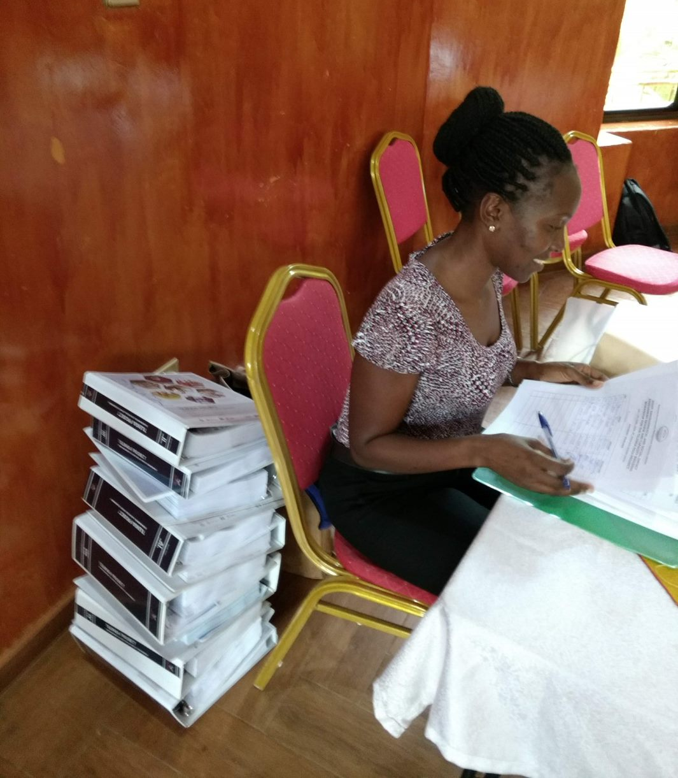
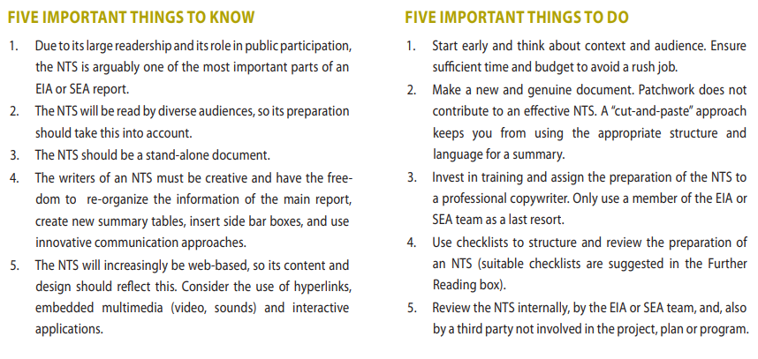
Presentation as important as content
6
Highlights
Recommendations
Project
info
ESIAs
& NCEA
From NCEA’s advisory review for the ESIA for EACOP,
27 juni 2019
The ESIA consists of 1011 pages (and 2600 pages of attachments), which makes it difficult to read and understand it properly. Because of the size, it is inevitable to pay less attention to sections, skip them, or skip fairly large parts.
The ESIA document/process is not transparent: it is impossible to follow how potential impacts have been assessed, mitigated and made acceptable. Particularly smart maps, highlighting Valued Ecological Components (VECs), sensitivities, impacts and solutions, are missing to present the reader an overview.
The ESIA is not ‘convergent’: it presents a wealth of data and details but fails to analyse these data in such a way that the key issues come out. The process to identify potential impacts, weigh them, find mitigation if required and motivate why impacts are acceptable after mitigation is not transparent.
One of the biggest challenges for ESIA consultants is to write a clear ESIA report that is relevant to decision-makers. The three ESIAs excelled in their number of pages, up to 5000 in the case of Tilenga for example. Although the reports presented a wealth of data and details, they failed to analyse these data in such a way as to bring the most important issues to the foreground. Information on what to do next in concrete terms, vanishes in the amount of information provided. And that is a waste of time and money with consequences for the sustainability of the project.
Therefore, we recommend paying as much attention to form as to content. In practice this means:
A clear executive summary without technical details.
Focus in the main text on key issues only. Add secondary issues and details to the annex.
Use clear language, especially in the main text. An ESIA report is not read by technical experts only.
Do not hesitate to ask for communication advice or someone to edit the report: it will pay off.
Make use of maps and visuals.
From IAIA’s fasttip no. 9: Non Technical Summary
The EACOP ESIA report

Slide 7
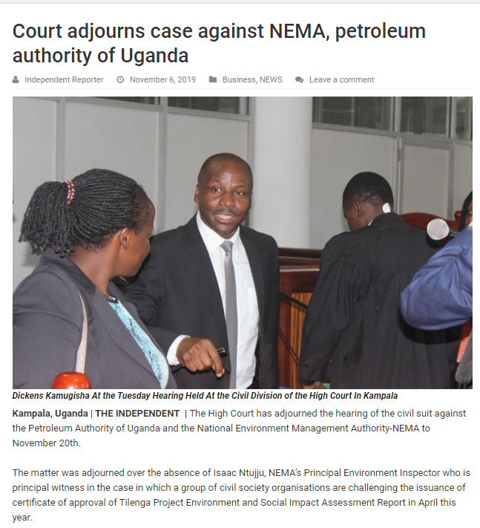
7
Highlights
Recommendations
Project
info
ESIAs
& NCEA
Finalise ESIA/ESMP before issuing certificate
Although the design of the environmental certificate has improved greatly, the process in all three cases has not been ideal. NEMA issued draft certificates even before the ESIA reports and full ESMPs were finalised. One of the reasons was that NEMA was under pressure to speed up the process.
We strongly recommend planning realistically and completing one step before moving on to the next, even in times of pressure. Taking the time at the right moment will save time (and money) later in the process. New insights may arise, even during the last review session, or public consultation. These new insights may have consequences for the conditions in the certificate. If they are not addressed at the right moment, lawsuits may be filed that further delay project development.
Uganda & Tanzania: NGOs petition regional court to stop construction of oil pipeline citing social & environmental concerns
....[A coalition of NGOs is] challenging the pipeline in the East African Court as a way to stop its development for the time being and challenge some of the environmental authorisations that have been approved. On the 10 September 2020, the Government of Uganda and Total International signed the Host Government Agreement for the EACOP project. A day later, the President of Uganda traveled to Tanzania to initiate the intergovernmental agreement with the Tanzanian government...
The organisations bringing the case argue that the agreements were signed without due regard to Uganda’s national laws and the East African Treaty. Uganda signed the agreements with Total E&P Limited without an approved Environmental and Social Impact Assessment from the National Environmental Management Authority, as required by law.
Source: Business and Human Rights Resource Centre

Slide 8
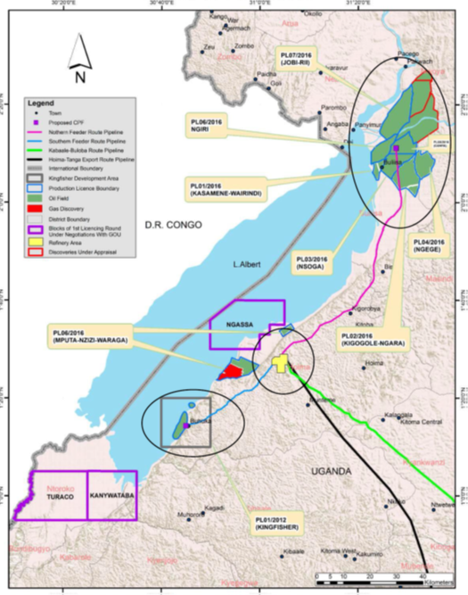
Project information
8
Highlights
Recommendations
Project
info
ESIAs
& NCEA
Tilenga - oil exploitation in and near Murchinson Falls National Park, by Tullow and Total
The Tilenga project covers over 1100 ha in the Western part of Murchinson Falls National Park, which includes Wildlife Reserves and a Ramsar Site (Victoria Nile). Permanent facilities include: 400 wells, 34 well pads across 6 oil fields An industrial area, including a Central Processing Facility (CPF), drilling support base, water treatment and reinjection facility 181 km pipelines between CPF and well-pads Pipelines under the Victoria Nile Water abstraction system from Lake Albert Victoria Nile Ferry Crossing Facility Tangi Operation Support Base (north of Victoria Nile) Bugungu airstrip Roads, stone quarries and borrow pits
Kingfisher- oil exploitation, including a 46 km feeder pipeline from Kingfisher to the Refinery in Kabaale, by CNOOC
The following infrastructure is planned within ca 10 by 2 km land area (Buhuka Flats): 31 Wells (20 production wells, 11 injection wells) from 4 well pads Connecting flowlines, roads to CPF CPF and accommodation, construction camp, materials yard, lay down areas for construction, etc Lake water abstraction station 46km feeder pipeline from CPF to Kabaale
EACOP (Ugandan part) - export pipeline of 1,445 km which will route crude oil from the Kabaale Refinery to an export terminal on the Tanzanian coastline including a 90 km feeder pipeline from Tilenga to the Refinery.
Project infrastructure is as follows: 296 km buried and heated pipeline from Kabaale to Mutukula near border with Tanzania Two pumping stations to keep the oil moving and 4 electrical substations to power the heated cable 7 km new and upgraded permanent roads and 8 km temporary roads to get to construction facilities 4 main camps where pipe and equipment will be stored and construction workers housed.
Circles from upper right to lower left: Tilenga, Kabaale Refinery and Kingfisher. Blue and purple lines are feeder pipelines, black line is part of EACOP (East African Crude Oil Pipeline).

Slide 9

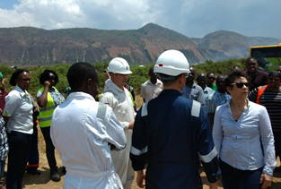

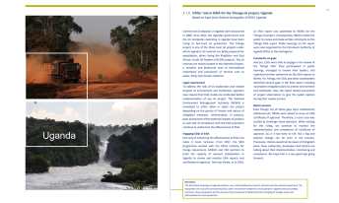

ESIA process steps
9
Highlights
Recommendations
Project
info
ESIAs
& NCEA
Capacity development civil society
Tilenga
December 2015 - scoping report submitted May 2018 – ESIA submitted to NEMA July 2018 - The NCEA contributed to a joint review workshop with lead agencies and district officials November 2018 - Public hearings February 2019 – Total / ESIA consultant submit updated ESMP March 2019 – NEMA issued Environmental Certificate. Autumn 2020: updated ESMP submitted to NEMA August 2021: ESMP reviewed by NEMA with input from NCEA
info
Being a partner in the Shared Resources Joint Solutions programme with IUCN-NL and WWF-NL, the NCEA gave workshops and training for local civil society organisaties on stakeholder involvement in ESIA and SEA. Read more about the SRJS programme in Uganda.
In the media
The NCEA’s advisory reports have been quoted in various news- and journal articles.
Cut-off and forgotten?: Livelihood disruption, social impacts and food insecurity arising from the East African Crude Oil Pipeline – Tom Ogwang & Frank Vanclay – Energy Research & Social Science – April 2021
De olie van Oeganda maakt straks een lange reis door de natuur – Trouw 5 maart 2021
Major Oil Pipeline Project Strikes Deep at the Heart of Africa – Fred Pearce YaleEnvironment360 – May 2020
Concerns raised over ESIA report for Eacop project - Upstream - July 2019
Kingfisher
September 2015 – Scoping report submitted December 2018 - ESIA submitted to NEMA February 2019 – the NCEA contributed to a joint review with lead agencies and district officials June 2019 - Public hearings November 2019 – updated ESIA after sending review comments and those made during the public hearings to CNOOC February 2020 - NEMA issued Environmental Certificate.
info
Site visit Kingfisher by NCEA’s group of experts, February 2019
EACOP (Ugandan part)
July 2017 - Scoping report submitted, jointly reviewed by NEMA and NCEA January 2019 – ESIA submitted to NEMA July 2019 - NCEA contributed to a joint quality review workshop with lead agencies and district officials November 2019 - stakeholder consultation where affected districts were clustered in 3 public hearing events. February 2020 - draft revised ESIA submitted. September 2020 – The NCEA reviewed updated ESIA November 2020 – NEMA issued Environmental Certificate The transboundary nature of EACOP is complicated: NEMC (Tanzania) reviewed the ESIA on the Tanzanian territory and issued an Environmental Certificate before NEMA did.
info
About the NCEA
Contact
The NCEA supports environment and sector ministries, environmental assessment professionals and non-governmental organisations, to improve their environmental and social assessment practice. The NCEA advises on the quality of the process and content of these assessments, both at project level (environmental and social impact assessment or ESIA) and strategic level (strategic environmental assessment or SEA). Since 1993, we issued more then 500 advisory reports and undertook training, workshops and coaching in more then 100 countries.
Ineke Steinhauer
+31 30 234 76 54
www.eia.nl
Notes:
Link naar Uganda case SRJS + tekst, evt zoom. Foto kingfisher, feb 2019. Stukje over NCEA algemeen, contactpersoon Ineke, .

Slide 10
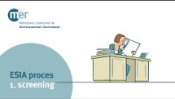

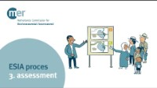

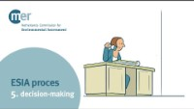
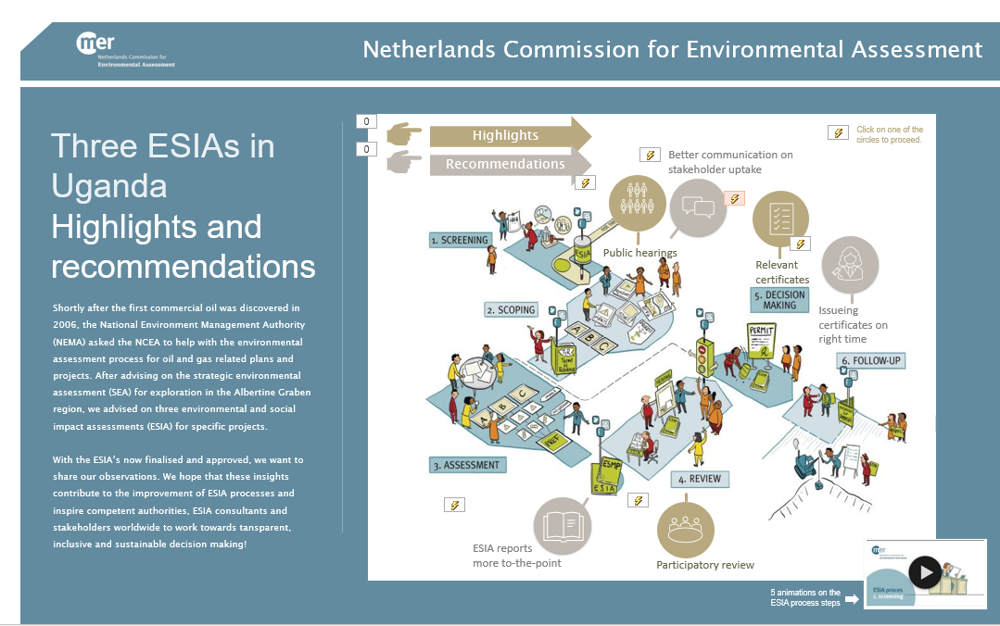
10
10
Highlights
Recommendations
Project
info
ESIAs
& NCEA
The ESIA process in 5 steps (step 6 underway)
If content is not automatically enabled, click here to view the animations on our website.
Back to home

Slide 11
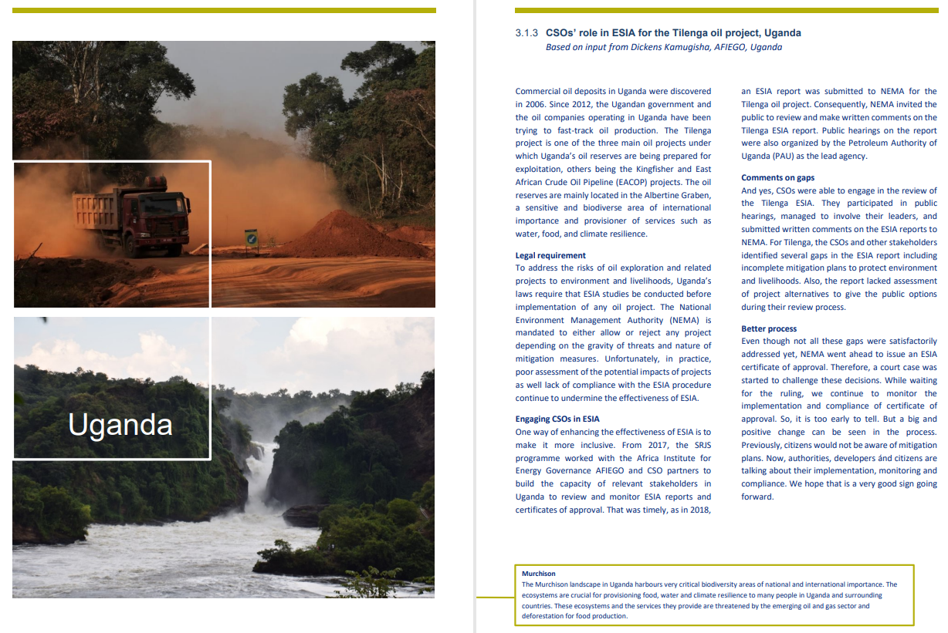
Project
info
ESIAs
& NCEA

